Slide 1
Explanation Insights (with Clustering)
**DATAROBOT INTERNAL USE**
Its ok to share the idea and some slides with customers, but we have spent a lot of time building these methods and don’t want our competitors to learn from our experience -- so use your judgement in sharing the slides -- Our work is a year ahead of academic/industry and other competitors at this point.

Slide 2
Explanation Insights

Slide 3
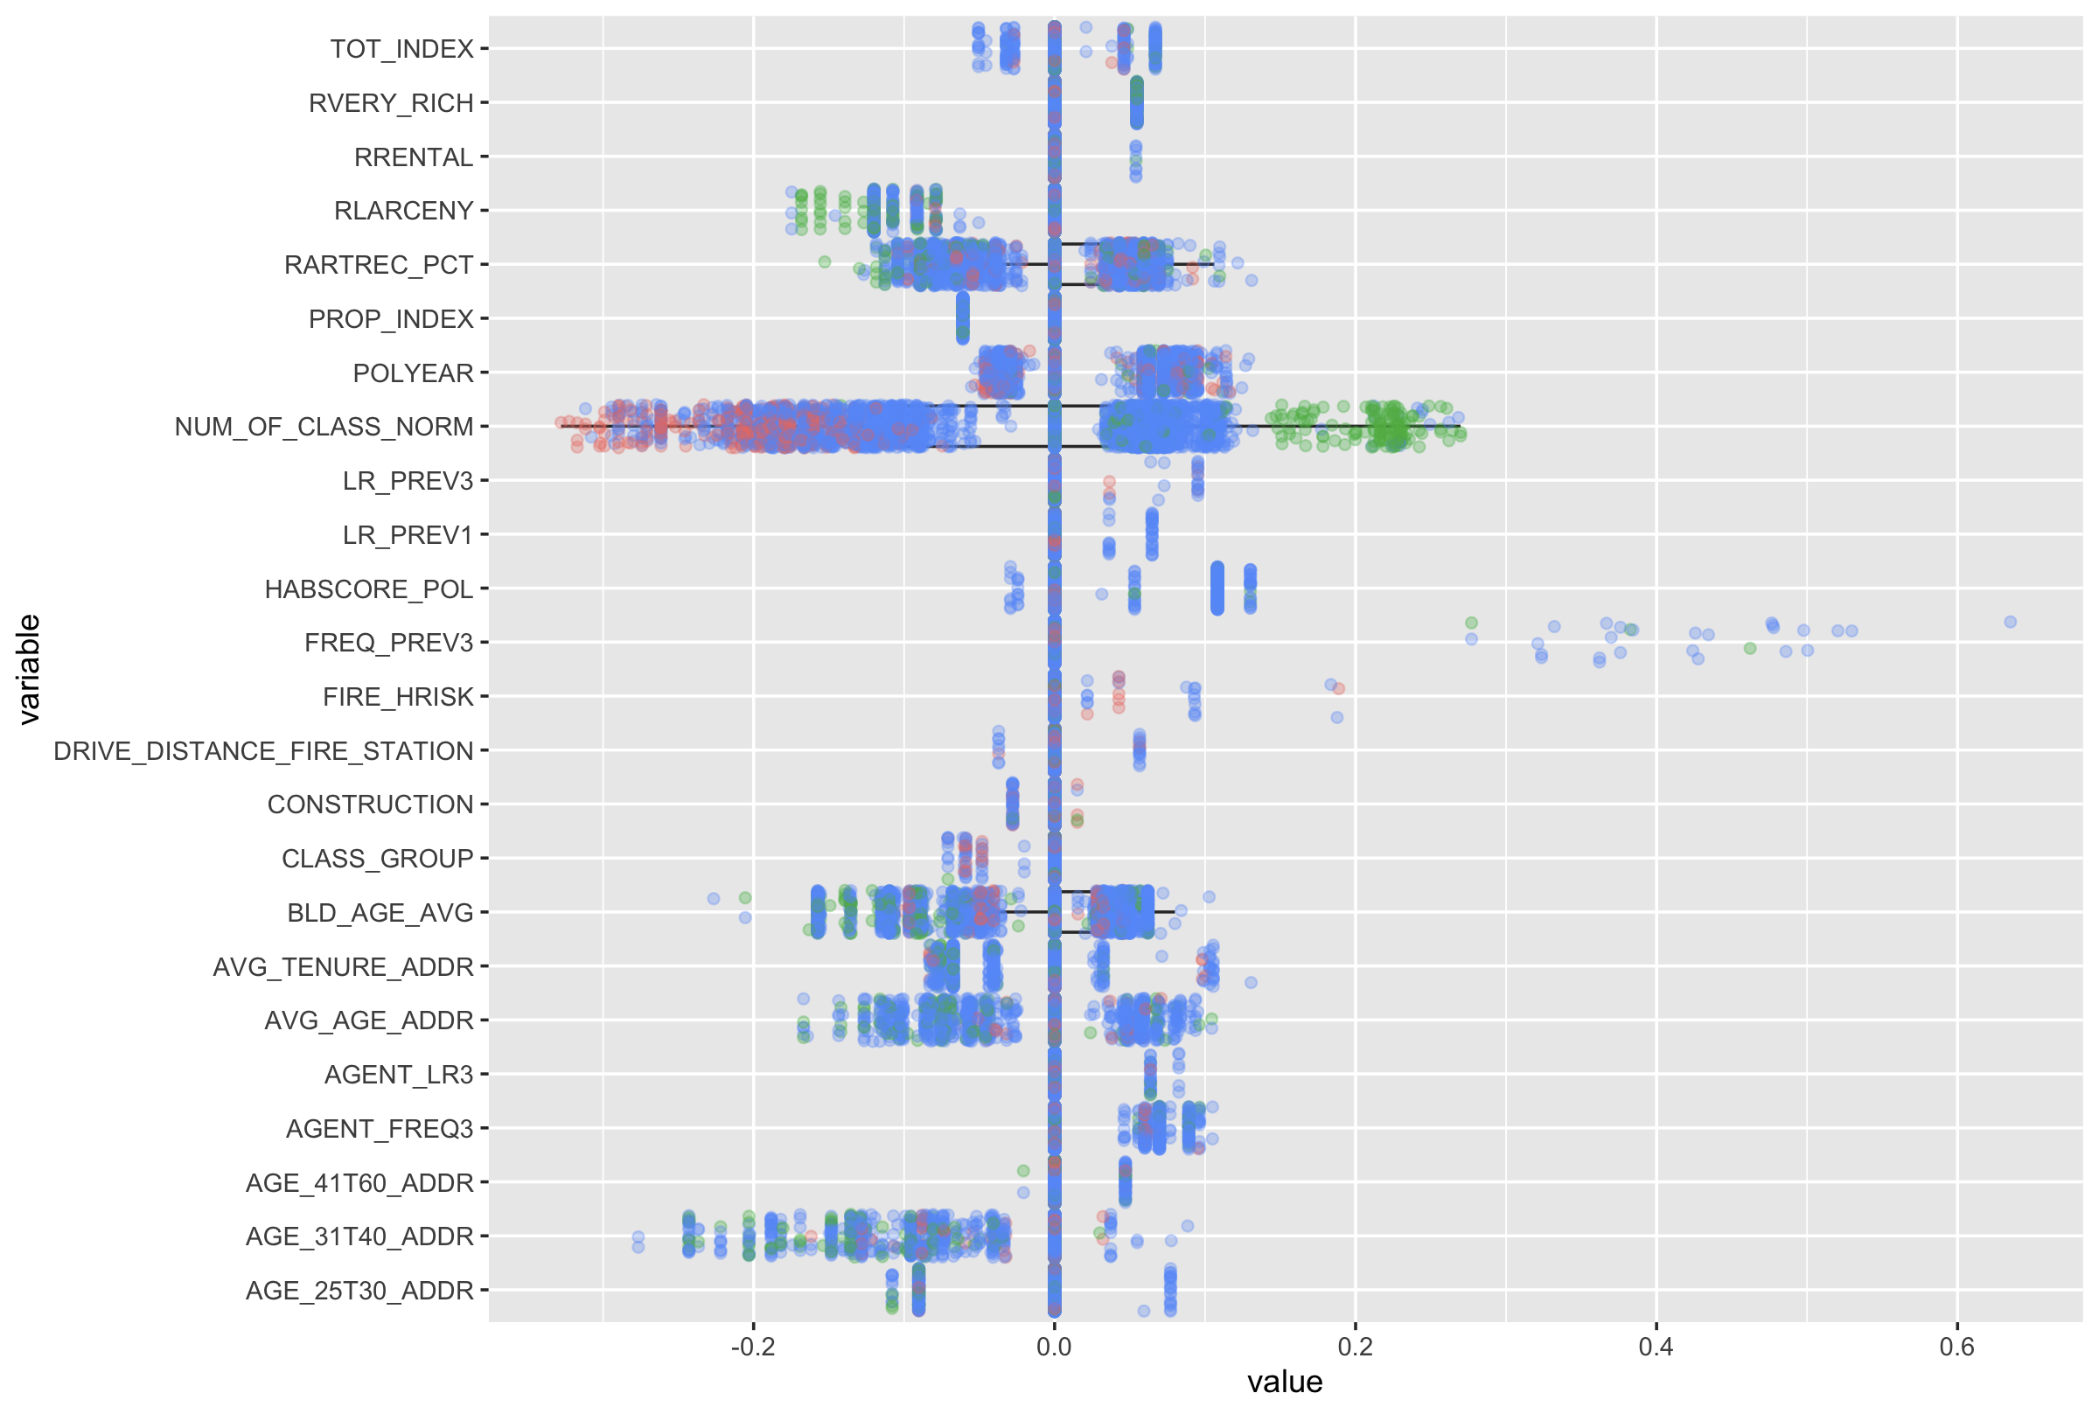
Insurance: Underwriting Segmentation
BACKGROUND
Identifying clusters of high and low loss ratio segments of their insurance book.
This did not require clustering, just plotting out the explanation strengths and segmenting by prediction
WHAT
Plotted prediction strengths for a dataset
Colors represent if it the prediction is high, low, or normal
See patterns for high and low predictions
Nick H. for a customer

Slide 4
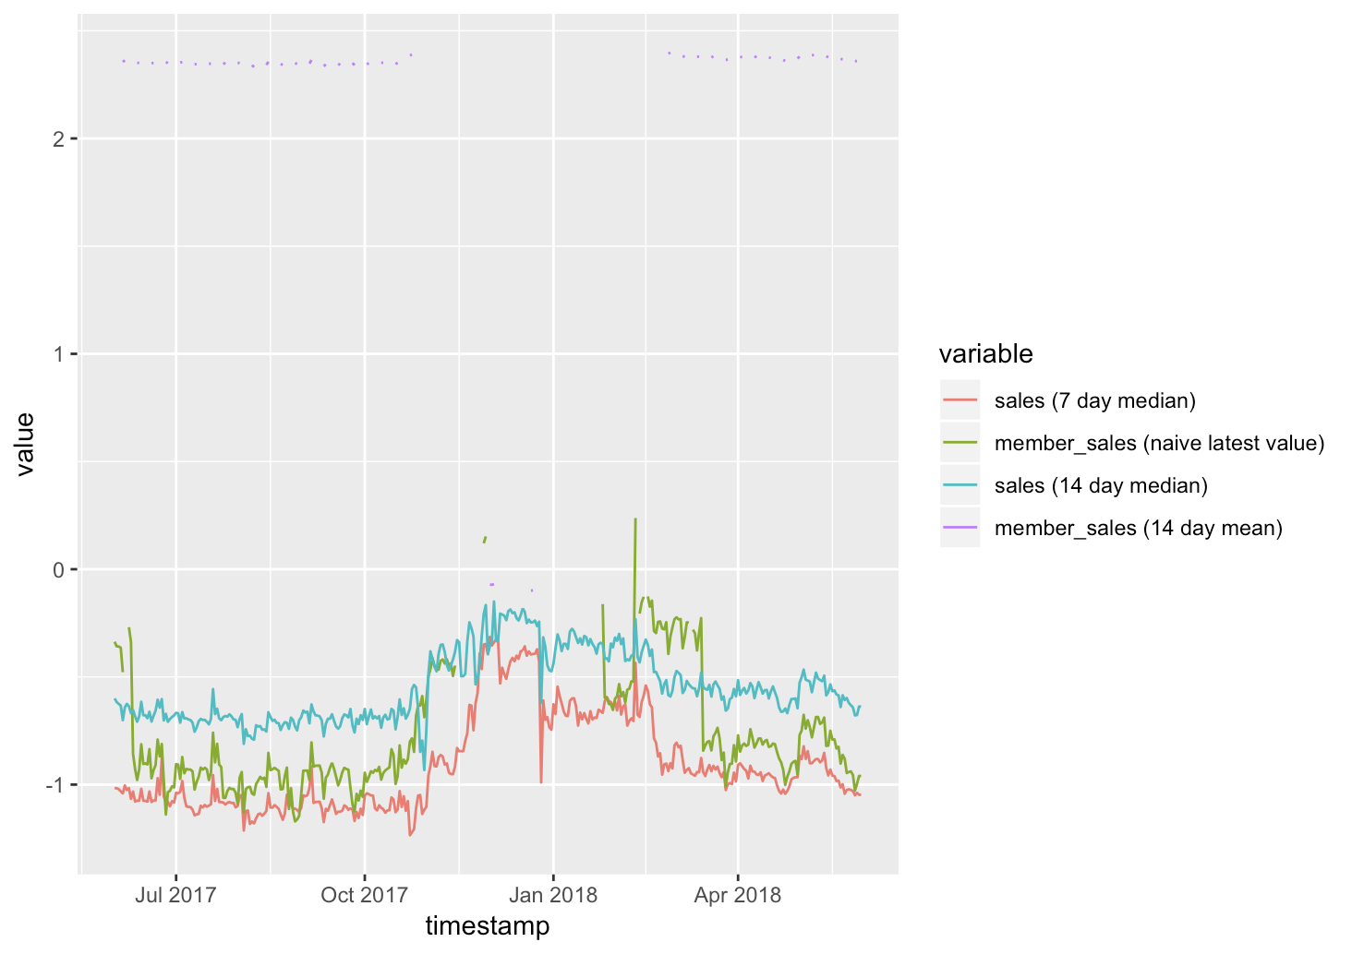
Time Series: Explanations for Sales
BACKGROUND
Using explanations to generate personalized messages for marketing
Use these explanations to group together customers who will purchase for the same reasons.
Use these explanations to personalize the message a customer sees.
Plotting top 5 explanations strengths over time for Jewelry
Member_sales (14 day mean) strong occasional, regular effect
Forecast distance = 1
Thakur

Slide 5
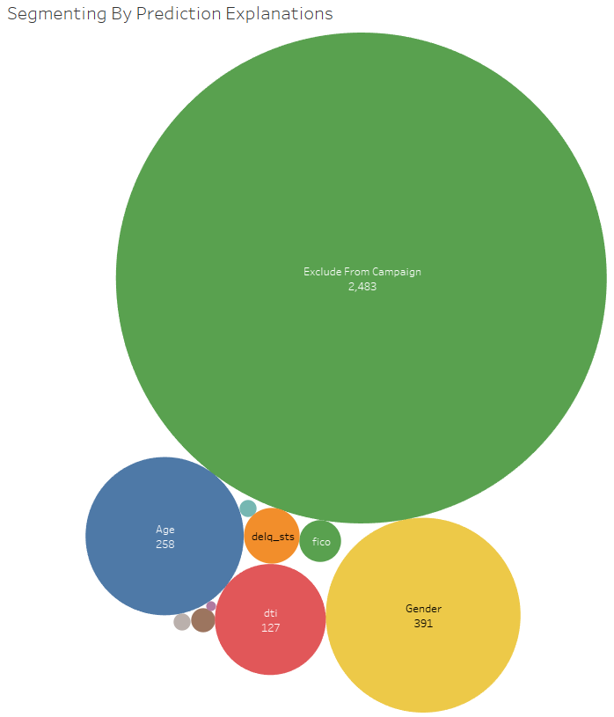
Marketing: Generating Personalized Messages
BACKGROUND
Using explanations to generate personalized messages for marketing
Segment customers based on explanations who will purchase for the same reasons.
Use these segments to personalize the message a customer sees.
Thakur

Slide 6
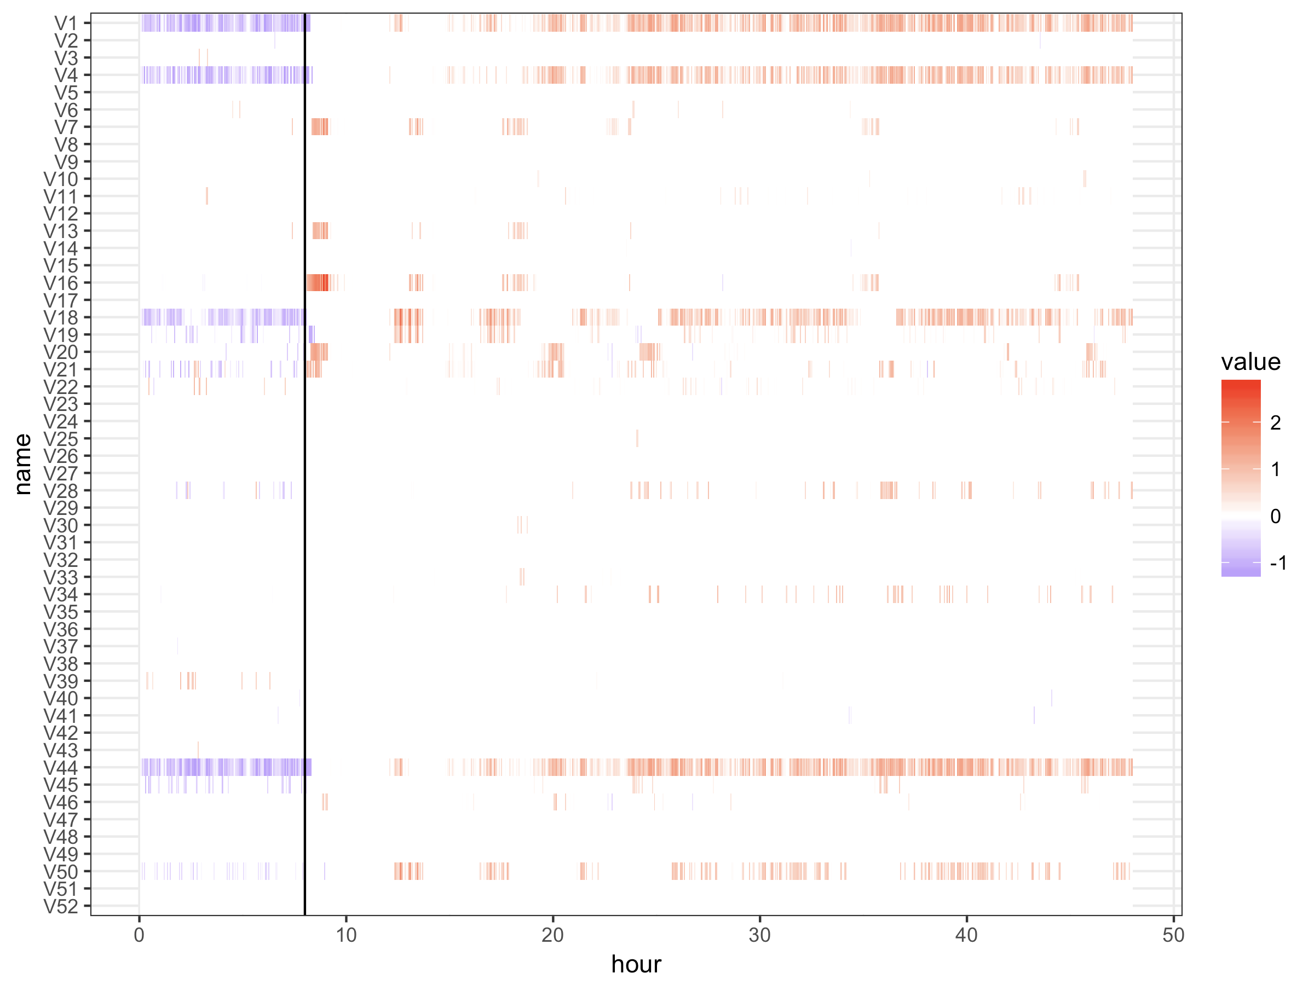
Explanations Over Time
APPROACH
Using explanations, it’s possible to understand the effect of the fault.
V1 (A Feed) and V44 (A Feed Flow) are strong contributors (indicated by the red color) for Fault 1.
After the fault, there is a contribution from a handful of process variables.
Over time, the fault is gradually propagated into V1 (A Feed) and V44 (A Feed Flow).
Based on Eastman Dataset and Yuya Y. has a customer in Japan using this method

Slide 7
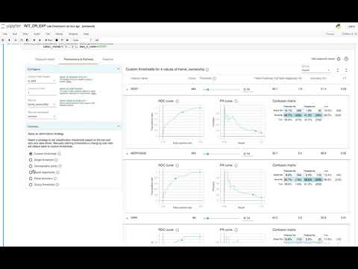
Using What-If Tool to Explore Explanations
APPROACH
The What-If App allows for exploring predictions and explanations on models created by DataRobot by integrating with the DataRobot Modeling API

Slide 8
Why Explanation Clustering

Slide 9
Clustering and Segmentation
RATIONALE
Millions of customers with different needs and purchasing behaviors
Although we recommend building models at an individual level, there are several reasons to understand what cluster or segment a customer falls into.
Grouping customers makes it easier to tell a narrative about what a model is doing.
Certain actions, such as marketing, may need clusters to be actionable
Broad Customer Segments Are No Longer Best Practice
Segment A
Segment B
VALUE
Segment C
Explanation clustering is a technique to provide clusters based on the explanations of a supervised machine learning model
Segment A
Characteristics
Segment rules
Effective action
Segment B
Characteristics
Segment rules
Effective action
Segment C
Characteristics
Segment rules
Effective action

Slide 10
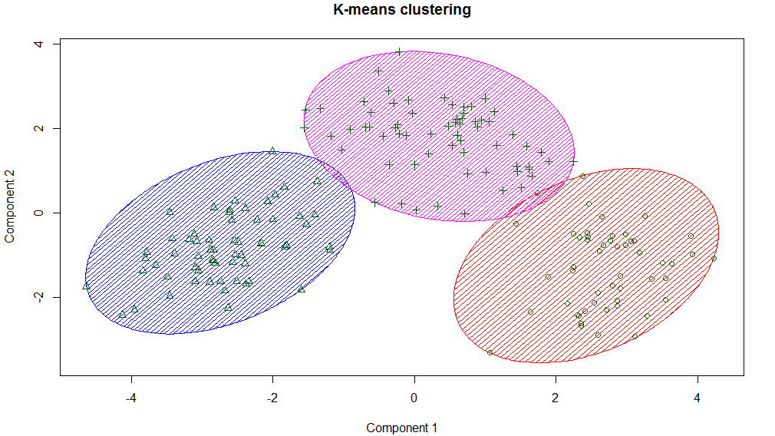
Why not just Cluster? . . Why Explanations?
Broad Customer Segments Are No Longer Best Practice
ISSUES
Selecting a clustering method - not clear which clustering method is preferable
Difficulty of dealing with high cardinality data and text data
Data science clustering typically weights all the features equally, including features that are of little relevance
Clustering is not connected to the underlying use case, such as identifying customers most likely to purchase
Notes:
https://www.google.com/url?sa=i&source=images&cd=&ved=2ahUKEwjTzL7dzOPkAhUCR6wKHVCXA8QQjRx6BAgBEAQ&url=https%3A%2F%2Ftowardsdatascience.com%2Fkmeans-clustering-for-classification-74b992405d0a&psig=AOvVaw2eUo5213gY9ejSeqac3ucR&ust=1569213135978609

Slide 11

Explanation Clustering
WHAT?
EXAMPLE
Explanation clustering groups predictions with similar explanations
Once groups are identified, it’s possible to:
Explain groups with high or low predictive probabilities
Identify different critical features that define groups
Provides a way to summarize data by using cluster centers as representatives
If you were predicting who would likely graduate from college, there are lots of relevant features . . . personal details, music preferences, eating preferences, favorite websites . . .
With clustering, it would use all this information
With explanation clustering, only the relevant columns for each row from the model (past high school grades, activities, SAT) would be used in creating the final set of clusters.
ADVANTAGES
Clustering offers a way to summarize general patterns present in the prediction explanations
Traditional distance metrics has trouble accounting for different units for features, high cardinality features, or text
Traditional clustering doesn’t know which are the most relevant features
Explanations offer standardized units and an ordering of features by row for what is relevant that succinctly summarizes a prediction

Slide 12
Explanation Clustering Methodology

Slide 13
Explanation Clustering Approach
ASSUMPTIONS
Start with a predictive model and a dataset to be explained
Clustering is conducted on the features that explain the predicted values (explanations)
This differs from unsupervised clustering, because we are using the explanations as the basis for clustering, rather than the dataset
METHOD
Start with the getting explanations for a dataset
Using a clustering algorithm on the explanations to group them
Join the cluster labels back to the dataset to the get characteristics of each cluster

Slide 14
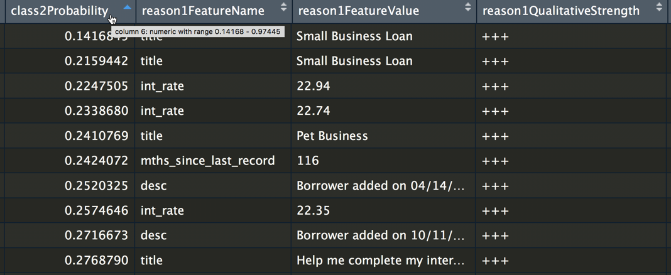
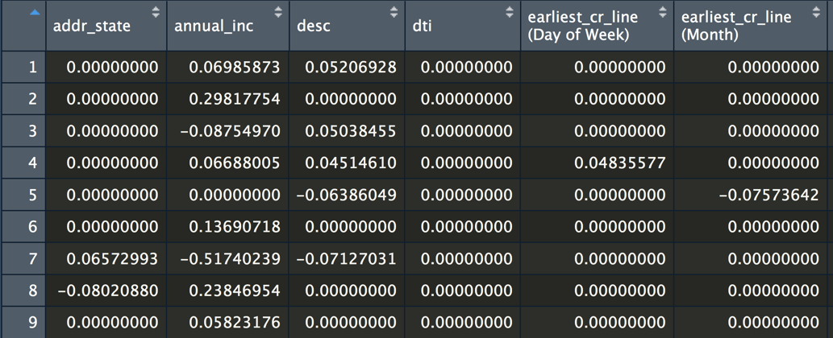
Flatten the explanations
FLATTEN EXPLANATIONS
RATIONALE
The first step is to flatten explanations, so each feature is a column with the value for that datapoint
Varying feature list and number of explanations will affect the flattened dataset
Possible to evaluate each datapoint on the basis of the explanations used
Serve as the dataset used for clustering

Slide 15
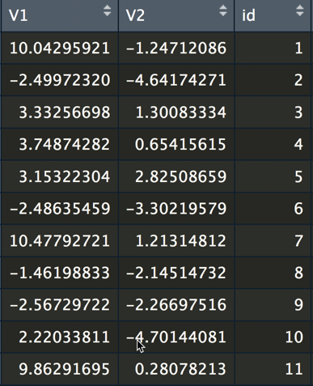
2. Create Explanation Embeddings
CREATE EMBEDDINGS
VISUALIZE
Reduce the dimensionality of the clusters
Our recommendation is Uniform Manifold Approximation and Projection (UMAP), but TSNE or PCA could be used
You may skip embeddings and go directly to clustering
A 2D embedding allows for visualization of the clusters
By changing the embedding settings, it provides a way to modifying the number of clusters, e.g, to create more clusters

Slide 16
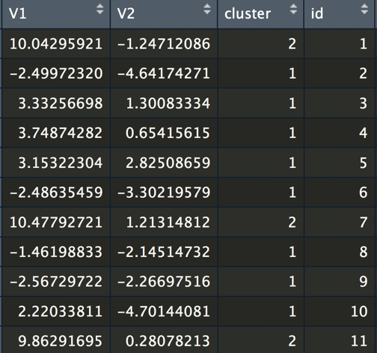
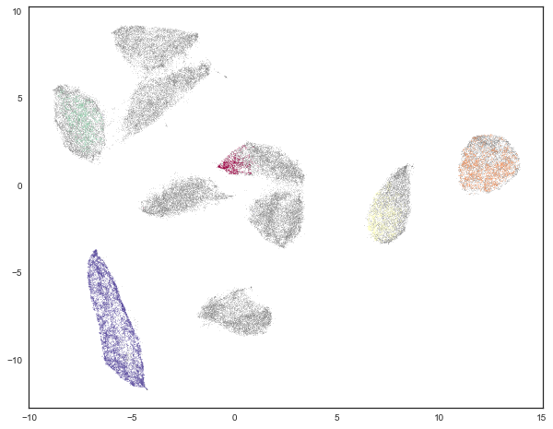
3. Get Cluster Labels
GET CLUSTER LABELS
WHY HDBSCAN
Label each datapoint with a cluster
Our recommendation is HDBSCAN, but you could use other clustering approaches like Kmeans
Density based clustering approach
Identified datapoints as either in a cluster or as noise
Works well with UMAP
Example of a poor clustering approach on the embeddings, because it only captures only a few clusters (in color) and the rest are labeled as noise (in gray).

Slide 17
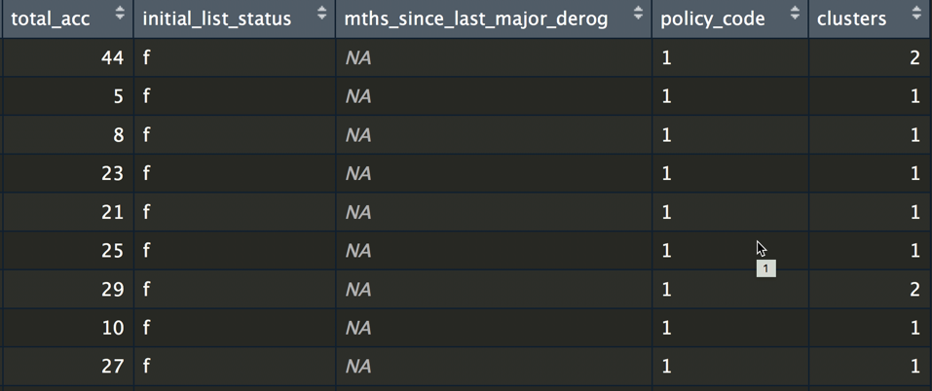
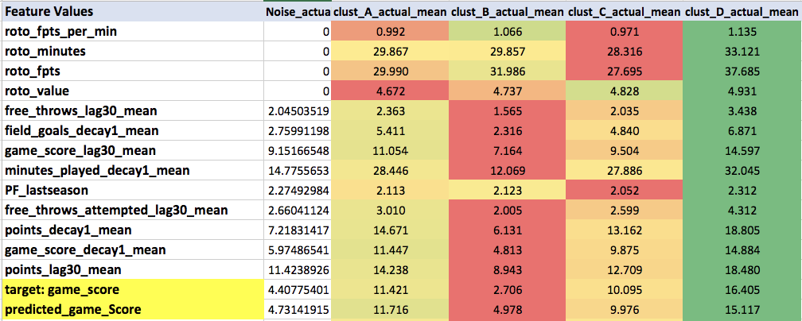
4. Join Clusters to Original Dataset
ADD LABELS TO DATASET
TYPES OF CLUSTERS
Join labels back to the dataset
Now using using grouping, it is possible to learn characteristics of the clusters
Focus on clusters that have the highest or lowest predictions
Simple approach is comparing means of actual values of the clusters with means of the explanations
Here we can see cluster D has a overall higher mean for these features

Slide 18
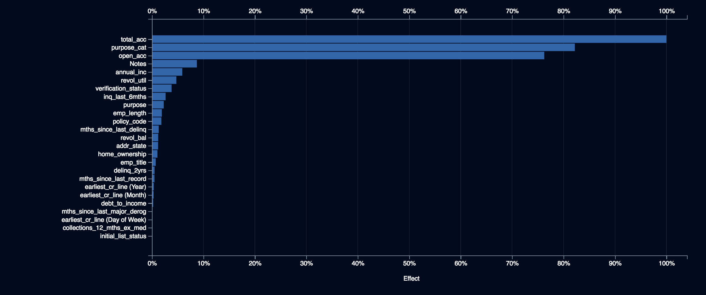
5. Interpret Clusters Using DataRobot
BUILD MODELS ON CLUSTERS
INTERPRET CLUSTERS
Build a model for each cluster using one versus all
Implemented in the R version of EXCL and will be added to the Python version
Use Feature Impact to identify features important for a cluster
Use partial dependence to analyze the effect of an important feature for a given cluster (likely to be different for the various clusters)
Feature Impact for one Cluster

Slide 19
Implementations of EXCL
R
Python
Taught in DataRobot’s Advanced R course (basic), better version here using UMAP
Find it on DataRobot’s internal data science scripts
Feature Impact for one Cluster

Slide 20
Additional Tips
The more features and more explanations, generally the more clusters there will be
Using UMAP settings to control how tightly clustered the data is
Using Excel is a nice way to share the clusters. If you include the predictions, it becomes easy to sort as well as slice and dice across clusters
Customers have seen this technique and like it a lot
Great for objection-handling when people ask about clustering

Slide 21
Applications of Explanation Clustering

Slide 22
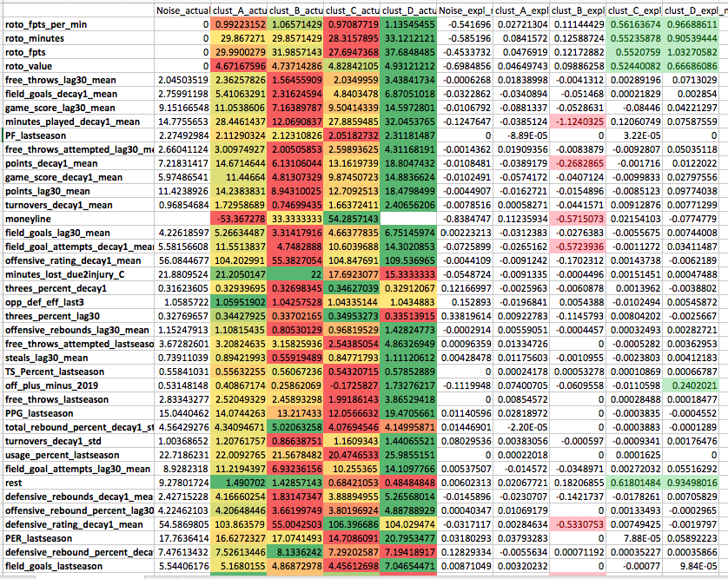
Sports Analytics
BACKGROUND
Feature Values
Explanation Strength
Analyzed NBA player performance, which resulted in 4 clusters of players. For example, Cluster D contains the players with high minutes and points.
Dataset from Ben M.

Slide 23
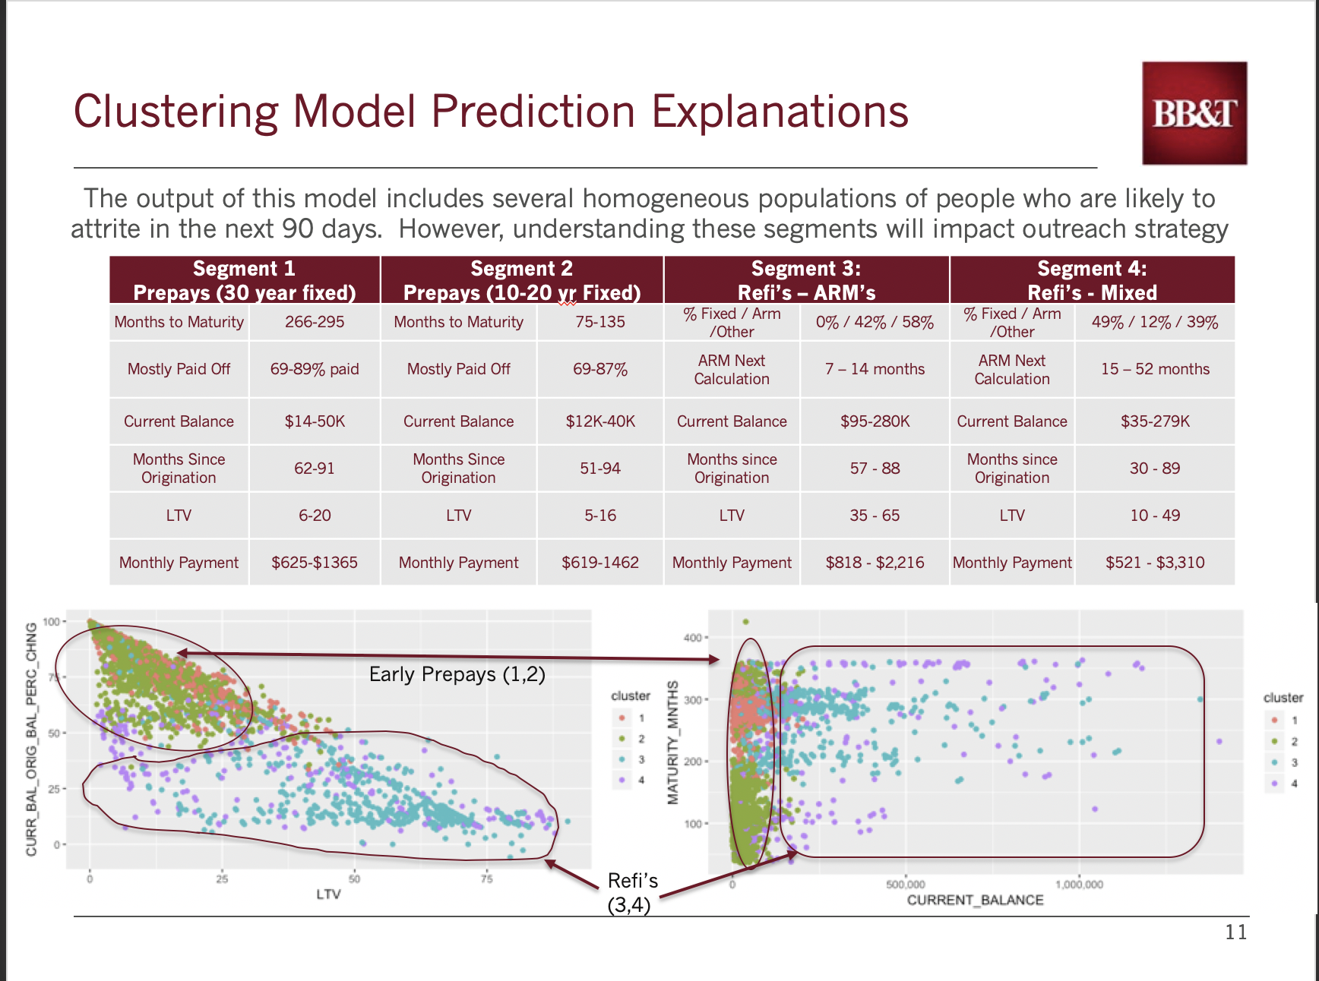
Banking: Loan Segmentation
BACKGROUND
By taking the clustering of prediction explanations for the ones predicted as yes (binary classification), It was possible to cluster into 4 groups and look at plots of the different variables and see that, yes there are indeed 4 groups or segments.
Caroline, Ben, and Omkar for a customer

Slide 24
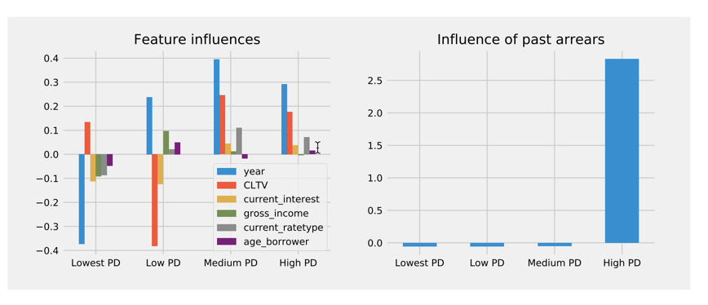
Banking: Loan Segmentation
BACKGROUND
Clustering explanations on probability of a loan in academic paper broken into four clusters by explanations
Academic paper

Slide 25
Time Series: Jay Example - Financial Services
BACKGROUND
Explanation clustering on a time series project
Jay S. for a customer

Slide 26
Healthcare: Suicide Prevention - Federal
BACKGROUND
By taking the clustering of prediction explanations for soldiers multiple segments materialized. The aggregate explanations of these segments identified new features which enhanced the overall model
Eric L

Slide 27
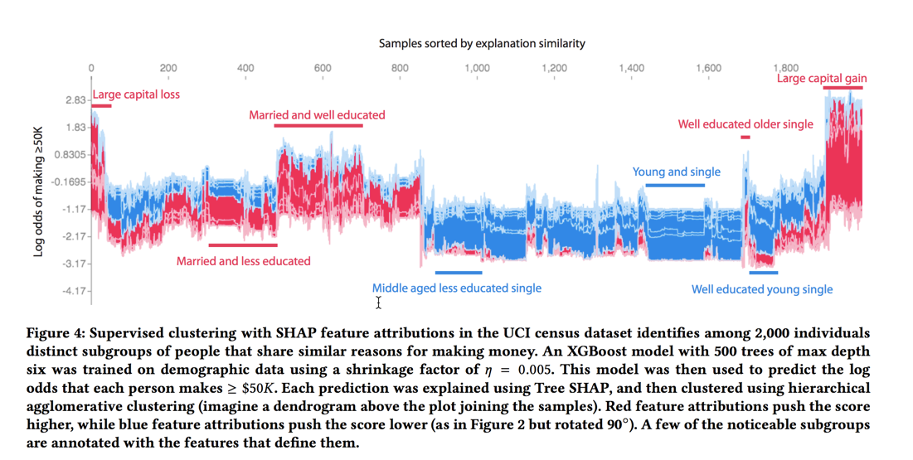
UCI Census Adult Dataset
Lundberg paper
Notes:
https://arxiv.org/pdf/1802.03888.pdf

Slide 28
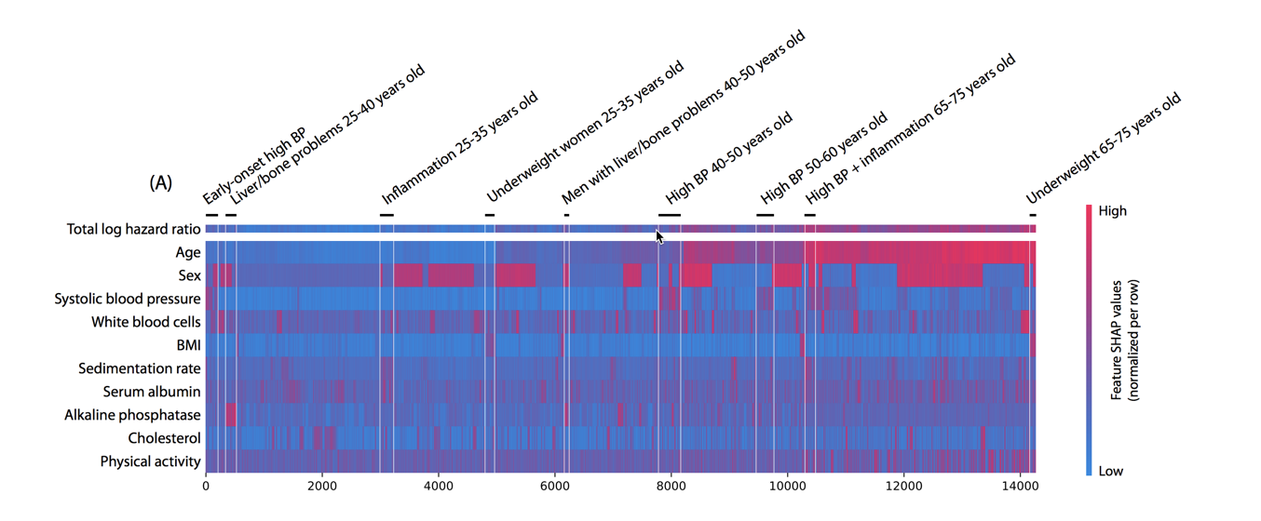
Mortality Dataset
BACKGROUND
A clustering of mortality study individuals by their local explanation embedding. Columns are patients, and rows are features’ normalized SHAP values. Sorting by a hierarchical clustering reveals population subgroups that have distinct mortality risk factors.
Lundberg paper
Notes:
https://arxiv.org/pdf/1905.04610.pdf

